Slide 1
IMDB Score Prediction for Movies

Slide 2
Library
#Import libraries import numpy as np import pandas as pd import matplotlib.pyplot as plt import seaborn as sns from plotnine import *

Slide 3
Introduction
1.1 Background
This dataset contains the information about the movies . For a movie to be commercial success , it depends on various factors like director, actors ,critic reviews and viewers reaction. Imdb score is one of the important factor to measure the movie's success.

Slide 4
1.2 Description of dataset attributes

Slide 5
Please find the details for the datset attributes:-
Color :- Movie is black or coloured
Director_name:- Name of the movie director
num_critic_for_reviews :- No of critics for the movie
duration:- movie duration in minutes
director_facebook_likes:-Number of likes for the Director on his Facebook Page
actor_3_facebook_likes:- No of likes for the actor 3 on his/her facebook Page
actor2_name:- name of the actor 2
actor_1_facebook_likes:- No of likes for the actor 1 on his/her facebook Page
gross:- Gross earnings of the movie in Dollars
genres:- Film categorization like ‘Animation’, ‘Comedy’, ‘Romance’, ‘Horror’, ‘Sci-Fi’, ‘Action’, ‘Family’
actor_1_name:- Name of the actor 1
movie_title:-Title of the movie
num_voted_users:-No of people who voted for the movie
cast_total_facebook_likes:- Total facebook like for the movie
actor_3_name:- Name of the actor 3
facenumber_in_poster:- No of actors who featured in the movie poster

Slide 6
plot_keywords:-Keywords describing the movie plots
movie_imdb_link:-Link of the movie link
num_user_for_reviews:- Number of users who gave a review
language:- Language of the movie
country:- Country where movie is produced
content_rating:- Content rating of the movie
budget:- Budget of the movie in Dollars
title_year:- The year in which the movie is released
actor_2_facebook_likes:- facebook likes for the actor 2
imdb_score:- IMDB score of the movie
aspect_ratio :- Aspect ratio the movie was made in
movie_facebook_likes:- Total no of facebook likes for the movie

Slide 7
1.3 Case Study
The dataset here gives the massive information about the movies and their IMDB scores respectively. We are going to analyze each and every factors which can influence the imdb ratings so that we can predict better results.The movie with the higher imdb score is more successful as compared to the movies with low imdb score.

Slide 8
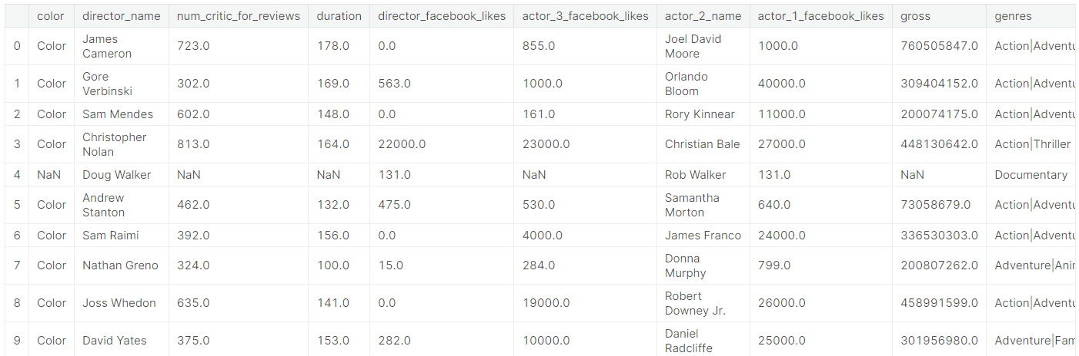
2. Data Preprocessing
#Reading the Data movie_df=pd.read_csv("/kaggle/input/imdb-5000-movie-dataset/movie_metadata.csv")
#Displaying the first 10 records movie_df.head(10)

Slide 9
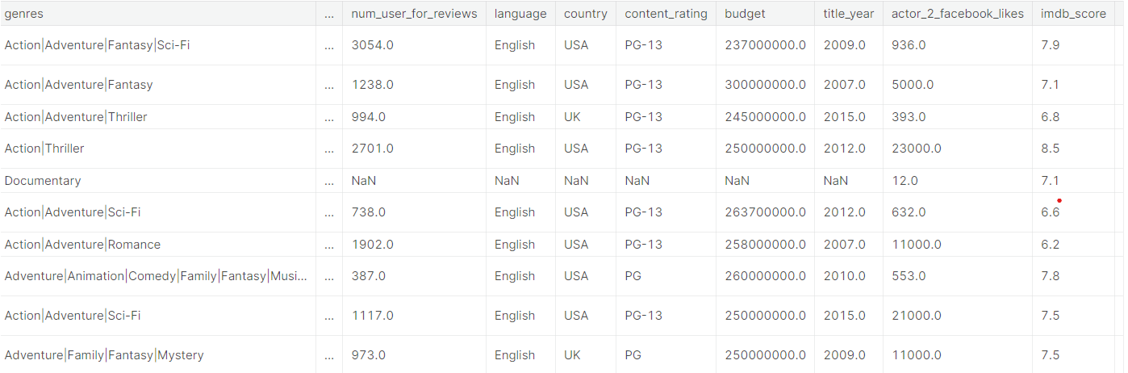

Slide 10
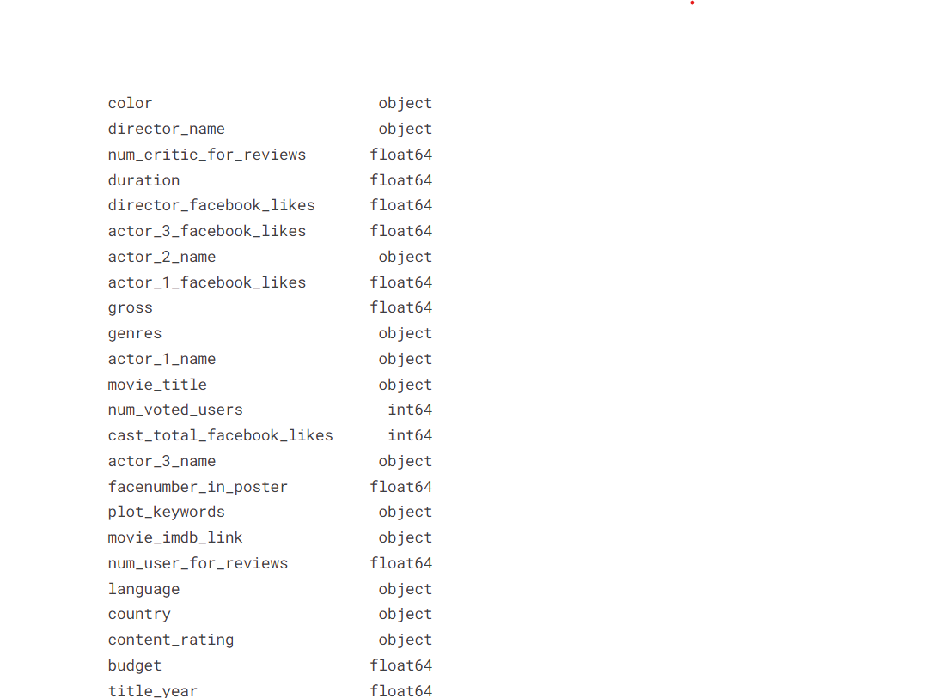
In: #Shape of the dataset (no of rows and no of columns) movie_df.shape
Out[4]:
Out: (5043, 28)
#Displaying the data type of the dataset attributes movie_df.dtypes

Slide 11
Categorical Columns
Color,Director name, actor name,genres,movie_title,language,country,content_rating.
Numerical Columns
num_critic_for_reviews,duration,director_facebook_likes ,actor_3_facebook_likes,actor_1_facebook_likes ,gross,num_voted_users,cast_total_facebook_likes,facenumber_in_poster,num_user_for_reviews ,budget,title_year, actor_2_facebook_likes ,imdb_score,aspect_ratio,movie_facebook_likes

Slide 12
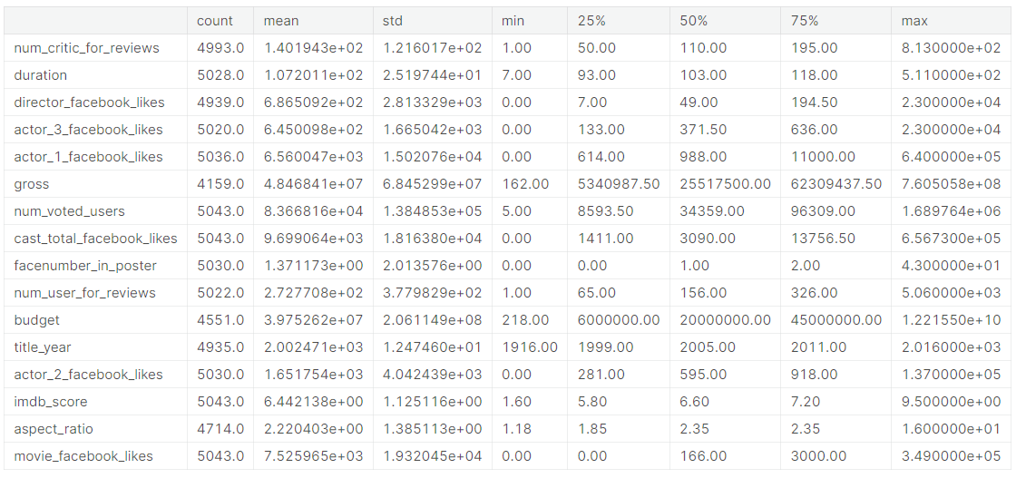
#Five point summary for the numerical columns in the dataset movie_df.describe().T

Slide 13
#Dropping the Imdb link from the dataset movie_df.drop('movie_imdb_link', axis=1, inplace=True)
#Removing the color section as most of the movies is colored movie_df["color"].value_counts() movie_df.drop('color',axis=1,inplace=True)
#Checking for the columns present in the datset movie_df.columns

Slide 14
Out:
Index(['director_name', 'num_critic_for_reviews', 'duration', 'director_facebook_likes', 'actor_3_facebook_likes', 'actor_2_name', 'actor_1_facebook_likes', 'gross', 'genres', 'actor_1_name', 'movie_title', 'num_voted_users', 'cast_total_facebook_likes', 'actor_3_name', 'facenumber_in_poster', 'plot_keywords', 'num_user_for_reviews', 'language', 'country', 'content_rating', 'budget', 'title_year', 'actor_2_facebook_likes', 'imdb_score', 'aspect_ratio', 'movie_facebook_likes'], dtype='object')

Slide 15
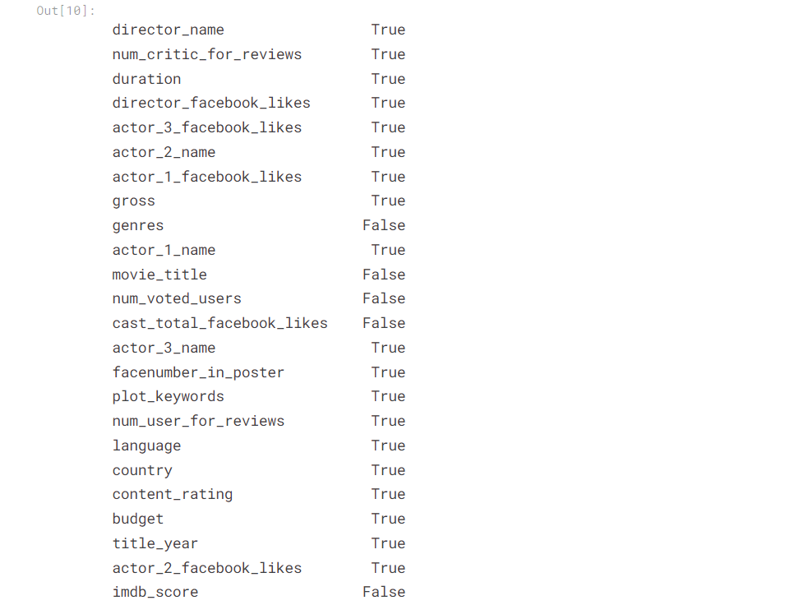
#Checking for the missing values in the dataset movie_df.isna().any()

Slide 16
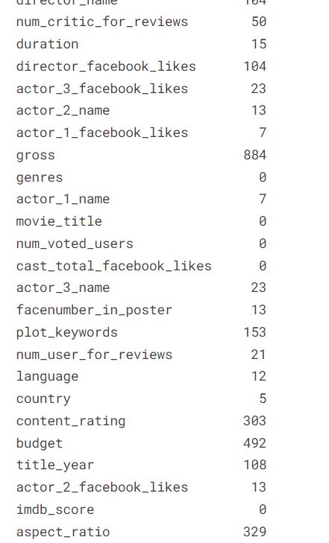
#No of the missing values in the dataset movie_df.isna().sum()

Slide 17
# We can remove the null values from the dataset where the count is less . so that we don't loose much data movie_df.dropna(axis=0,subset=['director_name', 'num_critic_for_reviews','duration','director_facebook_likes','actor_3_facebook_likes','actor_2_name','actor_1_facebook_likes','actor_1_name','actor_3_name','facenumber_in_poster','num_user_for_reviews','language','country','actor_2_facebook_likes','plot_keywords'],inplace=True)
movie_df.shape Out[13]:
(4737, 26)
#Replacing the content rating with Value R as it has highest frequency movie_df["content_rating"].fillna("R", inplace = True)
#Replacing the aspect_ratio with the median of the value as the graph is right skewed movie_df["aspect_ratio"].fillna(movie_df["aspect_ratio"].median(),inplace=True)

Slide 18
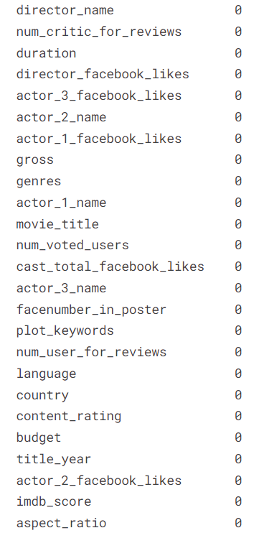
#We need to replace the value in budget with the median of the value movie_df["budget"].fillna(movie_df["budget"].median(),inplace=True)
# We need to replace the value in gross with the median of the value movie_df['gross'].fillna(movie_df['gross'].median(),inplace=True)
# Recheck that all the null values are removed movie_df.isna().sum()
#Removing the duplicate values in the datset movie_df.drop_duplicates(inplace=True) movie_df.shape
(4695, 26)
In [20]
#Count of the language values movie_df["language"].value_counts()

Slide 19
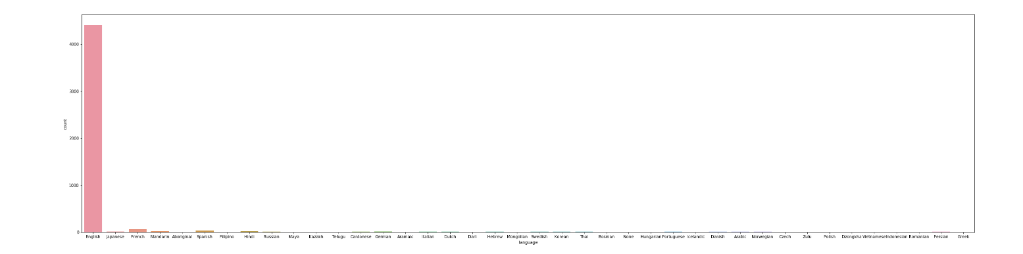
# Graphical presentaion plt.figure(figsize=(40,10)) sns.countplot(movie_df["language"]) plt.show()
#Most of the values for the languages is english we can drop the english column movie_df.drop('language',axis=1,inplace=True)

Slide 20
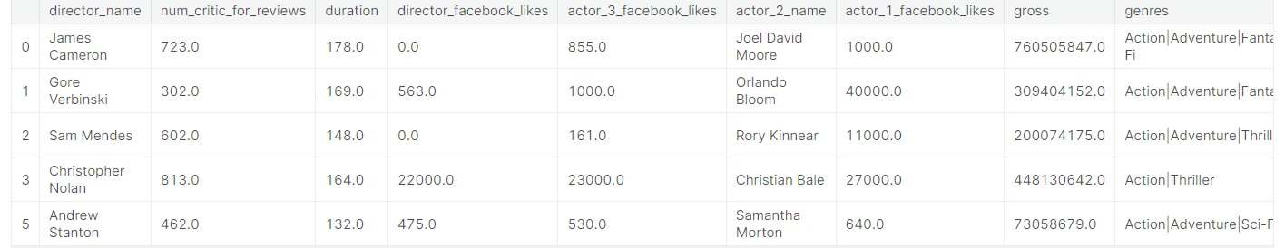
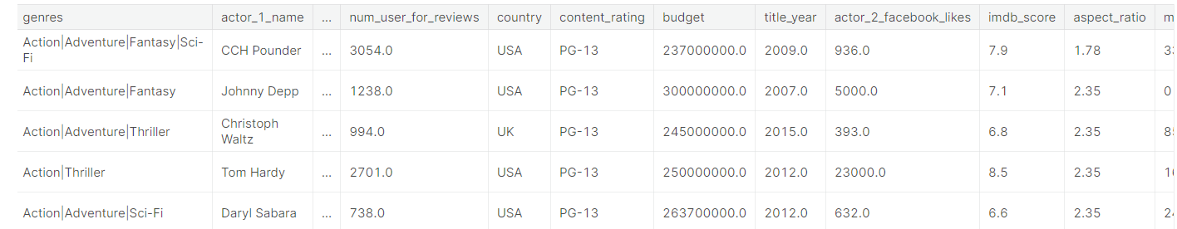
#Creating a new column to check the net profit made by the company (Gross-Budget) movie_df["Profit"]=movie_df['budget'].sub(movie_df['gross'], axis = 0) movie_df.head(5)

Slide 21
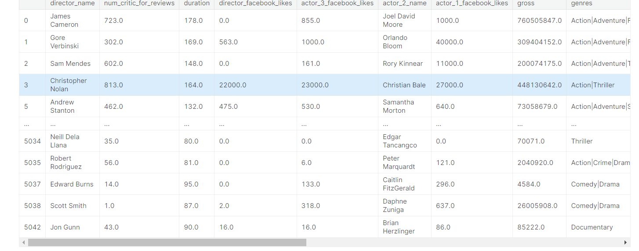
#Creating a new column to check the profit percentage made by the company movie_df['Profit_Percentage']=(movie_df["Profit"]/movie_df["gross"])*100 movie_df

Slide 22
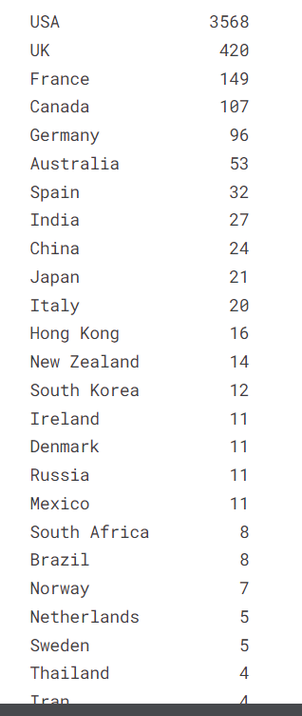
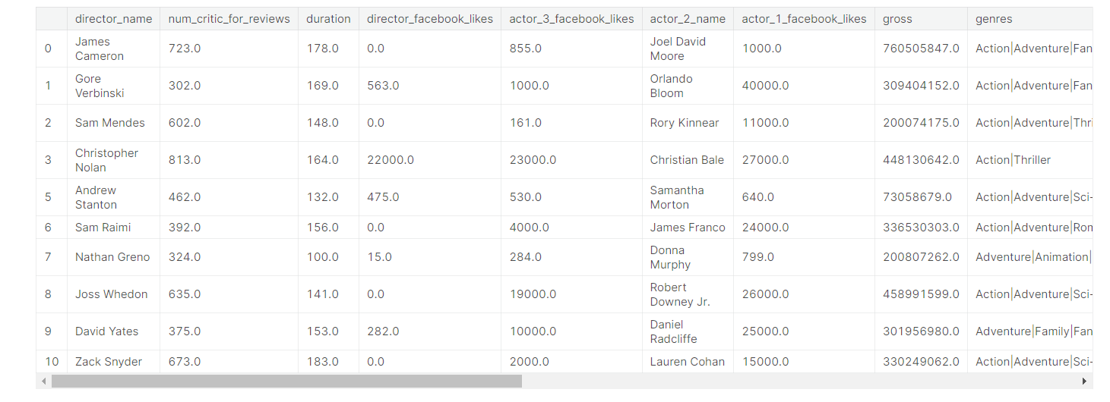
#Value counts for the countries value_counts=movie_df["country"].value_counts() print(value_counts)
##get top 2 values of index vals = value_counts[:2].index print (vals) movie_df['country'] = movie_df.country.where(movie_df.country.isin(vals), 'other')
Index(['USA', 'UK'], dtype='object')
#Successfully divided the country into three catogories movie_df["country"].value_counts()
USA 3568 other 707 UK 420 Name: country, dtype: int64
movie_df.head(10)

Slide 23
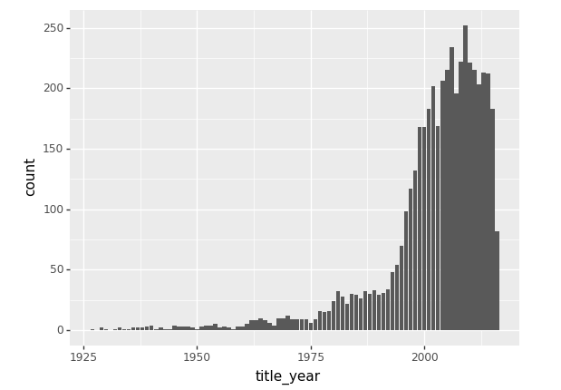
#Checking for the movies released year wise (ggplot(movie_df) # defining what data to use + aes(x='title_year') # defining what variable to use + geom_bar(size=20) # defining the type of plot to use )
/opt/conda/lib/python3.6/site-packages/plotnine/coords/coord_cartesian.py:31: MatplotlibDeprecationWarning: The Bunch class was deprecated in Matplotlib 3.0 and will be removed in 3.2. Use types.SimpleNamespace instead. self.limits = Bunch(xlim=xlim, ylim=ylim) /opt/conda/lib/python3.6/copy.py:274: MatplotlibDeprecationWarning: The Bunch class was deprecated in Matplotlib 3.0 and will be removed in 3.2. Use types.SimpleNamespace instead. y = func(*args) /opt/conda/lib/python3.6/site-packages/plotnine/facets/facet.py:151: MatplotlibDeprecationWarning: The Bunch class was deprecated in Matplotlib 3.0 and will be removed in 3.2. Use types.SimpleNamespace instead. scales = Bunch() /opt/conda/lib/python3.6/site-packages/plotnine/facets/layout.py:147: MatplotlibDeprecationWarning: The Bunch class was deprecated in Matplotlib 3.0 and will be removed in 3.2. Use types.SimpleNamespace instead. return Bunch(x=xsc, y=ysc)
Out:
<ggplot: (8779159653226)>
We can see the most of the movies which are released
after 1980.

Slide 24
#Relationship between the imdb score and the profit made by the movie ggplot(aes(x='imdb_score', y='Profit'), data=movie_df) +\ geom_line() +\ stat_smooth(colour='blue', span=1)
/opt/conda/lib/python3.6/site-packages/plotnine/coords/coord_cartesian.py:31: MatplotlibDeprecationWarning: The Bunch class was deprecated in Matplotlib 3.0 and will be removed in 3.2. Use types.SimpleNamespace instead. self.limits = Bunch(xlim=xlim, ylim=ylim) /opt/conda/lib/python3.6/copy.py:274: MatplotlibDeprecationWarning: The Bunch class was deprecated in Matplotlib 3.0 and will be removed in 3.2. Use types.SimpleNamespace instead. y = func(*args) /opt/conda/lib/python3.6/site-packages/plotnine/facets/facet.py:151: MatplotlibDeprecationWarning: The Bunch class was deprecated in Matplotlib 3.0 and will be removed in 3.2. Use types.SimpleNamespace instead. scales = Bunch() /opt/conda/lib/python3.6/site-packages/plotnine/facets/layout.py:147: MatplotlibDeprecationWarning: The Bunch class was deprecated in Matplotlib 3.0 and will be removed in 3.2. Use types.SimpleNamespace instead. return Bunch(x=xsc, y=ysc) /opt/conda/lib/python3.6/site-packages/numpy/core/fromnumeric.py:2389: FutureWarning: Method .ptp is deprecated and will be removed in a future version. Use numpy.ptp instead. return ptp(axis=axis, out=out, **kwargs)

Slide 25
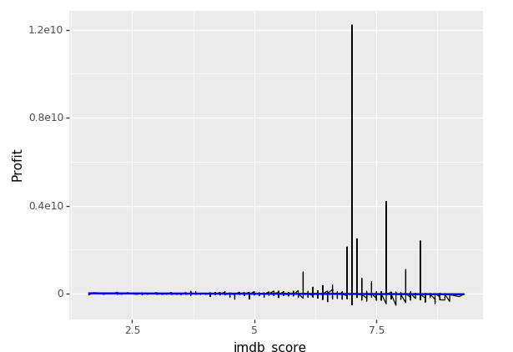
Out:
<ggplot: (8779159653317)>
We can see that there is strong corelation between the imdb_score and the profit . The movies with high imdb rating have made more profit

Slide 26
# Relationship between imdb score and profit percentage ggplot(aes(x='imdb_score', y='Profit'), data=movie_df) +\ geom_line() +\ stat_smooth(colour='blue', span=1)
/opt/conda/lib/python3.6/site-packages/plotnine/coords/coord_cartesian.py:31: MatplotlibDeprecationWarning: The Bunch class was deprecated in Matplotlib 3.0 and will be removed in 3.2. Use types.SimpleNamespace instead. self.limits = Bunch(xlim=xlim, ylim=ylim) /opt/conda/lib/python3.6/copy.py:274: MatplotlibDeprecationWarning: The Bunch class was deprecated in Matplotlib 3.0 and will be removed in 3.2. Use types.SimpleNamespace instead. y = func(*args) /opt/conda/lib/python3.6/site-packages/plotnine/facets/facet.py:151: MatplotlibDeprecationWarning: The Bunch class was deprecated in Matplotlib 3.0 and will be removed in 3.2. Use types.SimpleNamespace instead. scales = Bunch() /opt/conda/lib/python3.6/site-packages/plotnine/facets/layout.py:147: MatplotlibDeprecationWarning: The Bunch class was deprecated in Matplotlib 3.0 and will be removed in 3.2. Use types.SimpleNamespace instead. return Bunch(x=xsc, y=ysc) /opt/conda/lib/python3.6/site-packages/numpy/core/fromnumeric.py:2389: FutureWarning: Method .ptp is deprecated and will be removed in a future version. Use numpy.ptp instead. return ptp(axis=axis, out=out, **kwargs)

Slide 27
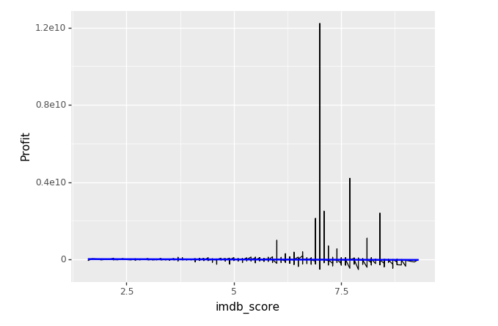
Out:
<ggplot: (8779159577103)>
Movies with high IMDB has made more percentage

Slide 28
#Checking for the imdb rating of the movies and compared with the countries ggplot(aes(x='country', y='imdb_score'), data=movie_df) +\ geom_line() +\ stat_smooth(colour='blue', span=1)
/opt/conda/lib/python3.6/site-packages/plotnine/coords/coord_cartesian.py:31: MatplotlibDeprecationWarning: The Bunch class was deprecated in Matplotlib 3.0 and will be removed in 3.2. Use types.SimpleNamespace instead. self.limits = Bunch(xlim=xlim, ylim=ylim) /opt/conda/lib/python3.6/copy.py:274: MatplotlibDeprecationWarning: The Bunch class was deprecated in Matplotlib 3.0 and will be removed in 3.2. Use types.SimpleNamespace instead. y = func(*args) /opt/conda/lib/python3.6/site-packages/plotnine/facets/facet.py:151: MatplotlibDeprecationWarning: The Bunch class was deprecated in Matplotlib 3.0 and will be removed in 3.2. Use types.SimpleNamespace instead. scales = Bunch() /opt/conda/lib/python3.6/site-packages/plotnine/facets/layout.py:147: MatplotlibDeprecationWarning: The Bunch class was deprecated in Matplotlib 3.0 and will be removed in 3.2. Use types.SimpleNamespace instead. return Bunch(x=xsc, y=ysc)

Slide 29
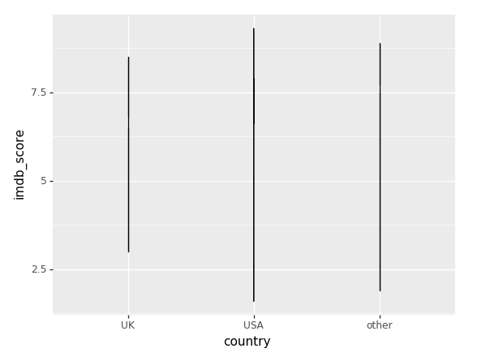
Out:
<ggplot: (-9223363257695236576)>
Most of the movies above rating 8.75 are from USA

Slide 30
#Finding the corelation between imdb_rating with respect to no of facebook likes (ggplot(movie_df) + aes(x='imdb_score', y='movie_facebook_likes') + geom_line() + labs(title='IMDB_Score vs. Facebook like for Movies', x='IMDB scores', y='Facebook Likes for movies') )
/opt/conda/lib/python3.6/site-packages/plotnine/coords/coord_cartesian.py:31: MatplotlibDeprecationWarning: The Bunch class was deprecated in Matplotlib 3.0 and will be removed in 3.2. Use types.SimpleNamespace instead. self.limits = Bunch(xlim=xlim, ylim=ylim) /opt/conda/lib/python3.6/copy.py:274: MatplotlibDeprecationWarning: The Bunch class was deprecated in Matplotlib 3.0 and will be removed in 3.2. Use types.SimpleNamespace instead. y = func(*args) /opt/conda/lib/python3.6/site-packages/plotnine/facets/facet.py:151: MatplotlibDeprecationWarning: The Bunch class was deprecated in Matplotlib 3.0 and will be removed in 3.2. Use types.SimpleNamespace instead. scales = Bunch() /opt/conda/lib/python3.6/site-packages/plotnine/facets/layout.py:147: MatplotlibDeprecationWarning: The Bunch class was deprecated in Matplotlib 3.0 and will be removed in 3.2. Use types.SimpleNamespace instead. return Bunch(x=xsc, y=ysc)

Slide 31
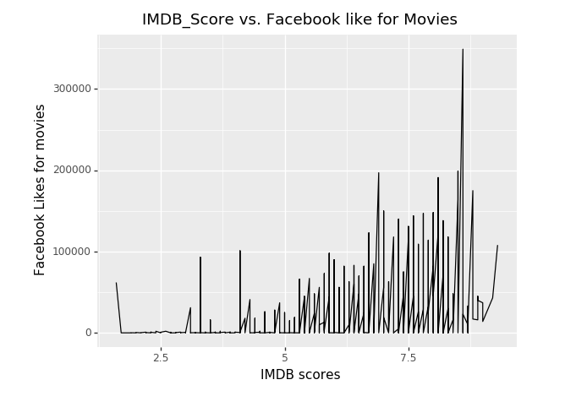
<ggplot: (8779159517781)>
Movie with high IMDB rating have most no of facebook likes

Slide 32
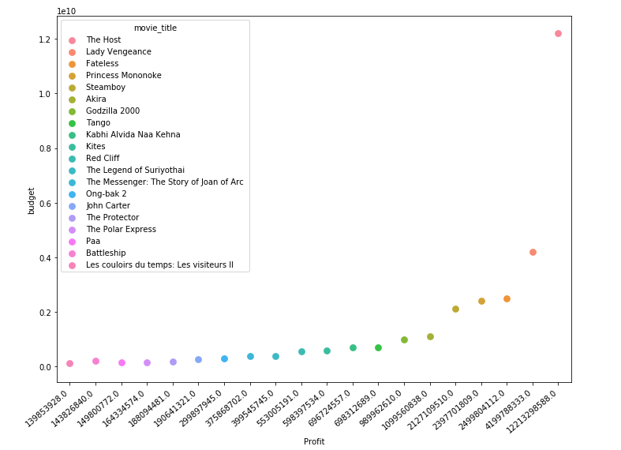
#Top 20 movies based on the profit they made plt.figure(figsize=(10,8)) movie_df= movie_df.sort_values(by ='Profit' , ascending=False) movie_df_new=movie_df.head(20) ax=sns.pointplot(movie_df_new['Profit'], movie_df_new['budget'], hue=movie_df_new['movie_title']) ax.set_xticklabels(ax.get_xticklabels(), rotation=40, ha="right") plt.tight_layout() plt.show()

Slide 33
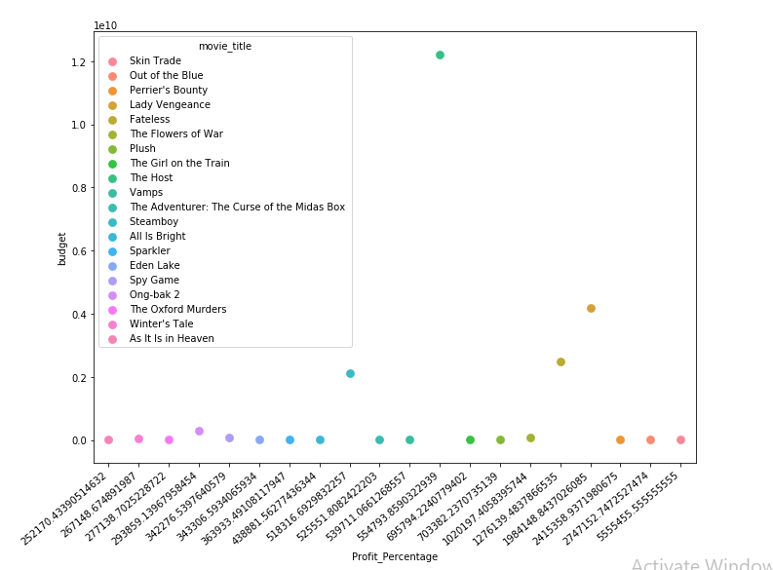
# Top 20 movies based on the profit percentage plt.figure(figsize=(10,8)) movie_df= movie_df.sort_values(by ='Profit_Percentage' , ascending=False) movie_df_new=movie_df.head(20) ax=sns.pointplot(movie_df_new['Profit_Percentage'], movie_df_new['budget'], hue=movie_df_new['movie_title']) ax.set_xticklabels(ax.get_xticklabels(), rotation=40, ha="right") plt.tight_layout() plt.show()

Slide 34
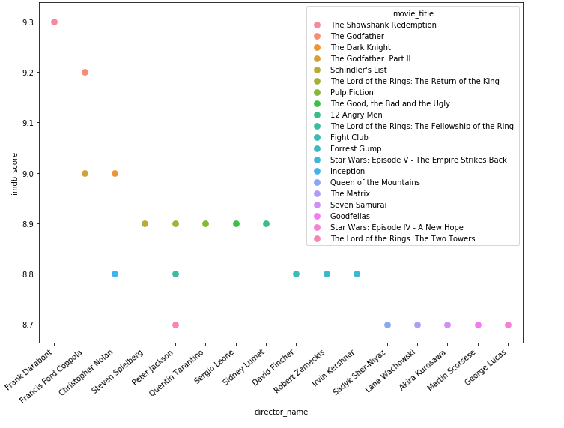
#Top 20 directors based on the IMDB ratings plt.figure(figsize=(10,8)) movie_df= movie_df.sort_values(by ='imdb_score' , ascending=False) movie_df_new=movie_df.head(20) ax=sns.pointplot(movie_df_new['director_name'], movie_df_new['imdb_score'], hue=movie_df_new['movie_title']) ax.set_xticklabels(ax.get_xticklabels(), rotation=40, ha="right") plt.tight_layout() plt.show()

Slide 35
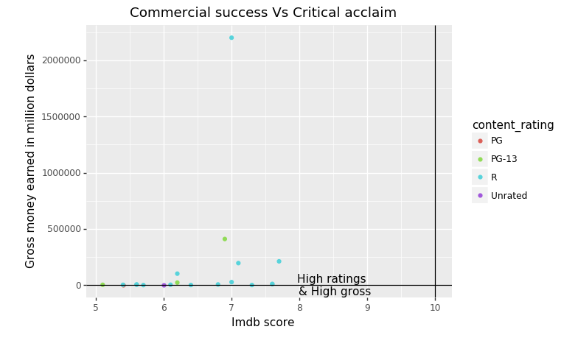
#Commercial success vs critial acclaim movie_df= movie_df.sort_values(by ='Profit_Percentage' , ascending=False) movie_df_new=movie_df.head(20) (ggplot(movie_df_new) + aes(x='imdb_score', y='gross',color = "content_rating") + geom_point() + geom_hline(aes(yintercept = 600)) + geom_vline(aes(xintercept = 10)) + xlab("Imdb score") + ylab("Gross money earned in million dollars") + ggtitle("Commercial success Vs Critical acclaim") + annotate("text", x = 8.5, y = 700, label = "High ratings \n & High gross"))
<ggplot: (8779159511195)>
Movies with High content rating were not commercial success

Slide 36
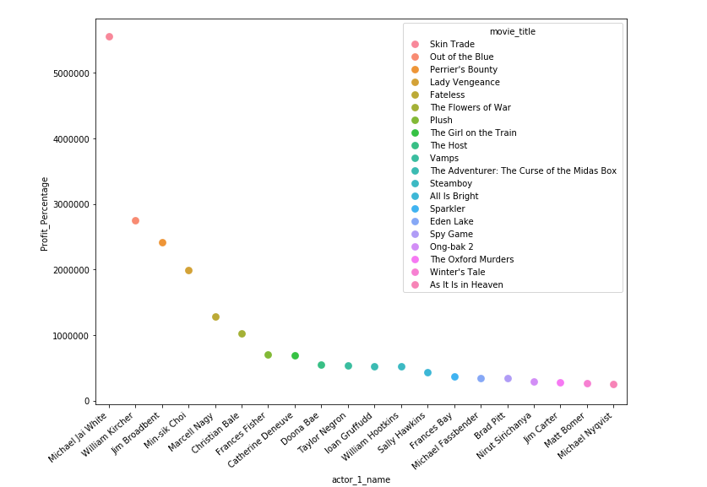
Top 20 actors of movies based on the commerical success plt.figure(figsize=(10,8)) movie_df= movie_df.sort_values(by ='Profit_Percentage' , ascending=False) movie_df_new=movie_df.head(20) ax=sns.pointplot(movie_df_new['actor_1_name'], movie_df_new['Profit_Percentage'], hue=movie_df_new['movie_title']) ax.set_xticklabels(ax.get_xticklabels(), rotation=40, ha="right") plt.tight_layout() plt.show()

Slide 37
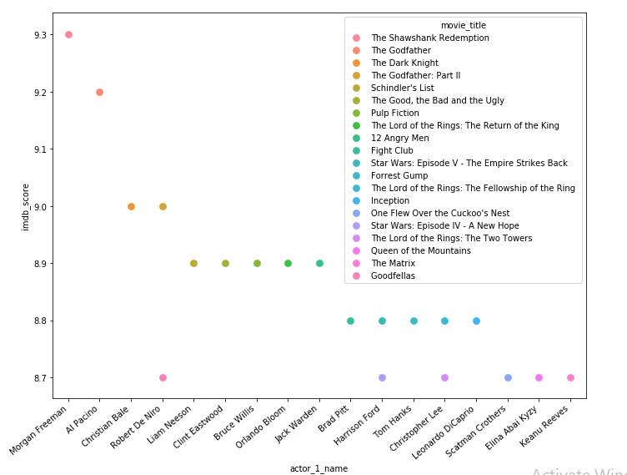
#Top 20 actors of movies based on the imdb rating of the movies plt.figure(figsize=(10,8)) movie_df= movie_df.sort_values(by ='imdb_score' , ascending=False) movie_df_new=movie_df.head(20) ax=sns.pointplot(movie_df_new['actor_1_name'], movie_df_new['imdb_score'], hue=movie_df_new['movie_title']) ax.set_xticklabels(ax.get_xticklabels(), rotation=40, ha="right") plt.tight_layout() plt.show()

Slide 38
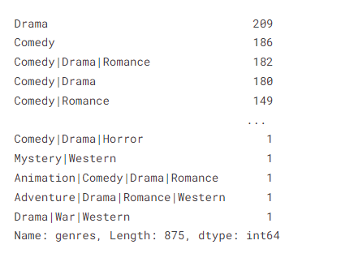
4.Data Preparation for the models 4.1 Removing the Columns with names
#Removing the director name column movie_df.drop('director_name', axis=1, inplace=True)
#Removing the actor1 ,actor 2 and actor 3 names movie_df.drop('actor_1_name',axis=1,inplace=True) movie_df.drop('actor_2_name',axis=1,inplace=True) movie_df.drop('actor_3_name',axis=1,inplace=True)
#Dropping the movie title movie_df.drop('movie_title',axis=1,inplace=True)
# Dropping the plot keywords movie_df.drop('plot_keywords',axis=1,inplace=True)
#Value count of genres movie_df['genres'].value_counts()

Slide 39
4.2 Remove the linear dependant variables
# Droping the profit column from the dataset movie_df.drop('Profit',axis=1,inplace=True)
In [50]:
#Dropping the profit percentage column from the dataset movie_df.drop('Profit_Percentage',axis=1,inplace=True)

Slide 40
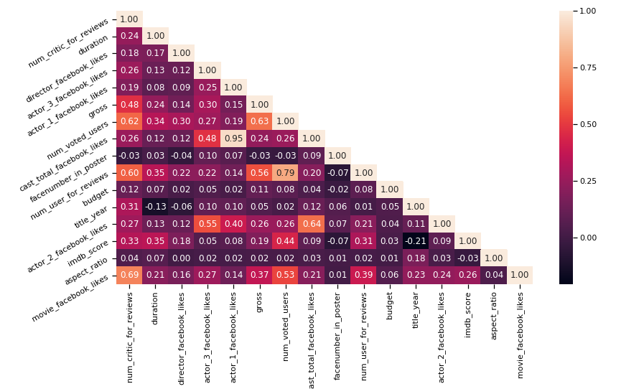
4.3 Remove the correlated variables
# Correlation with heat map import matplotlib.pyplot as plt import seaborn as sns corr = movie_df.corr() sns.set_context("notebook", font_scale=1.0, rc={"lines.linewidth": 2.5}) plt.figure(figsize=(13,7)) # create a mask so we only see the correlation values once mask = np.zeros_like(corr) mask[np.triu_indices_from(mask, 1)] = True a = sns.heatmap(corr,mask=mask, annot=True, fmt='.2f') rotx = a.set_xticklabels(a.get_xticklabels(), rotation=90) roty = a.set_yticklabels(a.get_yticklabels(), rotation=30)

Slide 41
5. Handling the categorical data
movie_df = pd.get_dummies(data = movie_df, columns = ['country'] , prefix = ['country'] , drop_first = True) movie_df = pd.get_dummies(data = movie_df, columns = ['content_rating'] , prefix = ['content_rating'] , drop_first = True)
movie_df.columns
Index(['duration', 'director_facebook_likes', 'actor_1_facebook_likes', 'gross', 'num_voted_users', 'facenumber_in_poster', 'budget', 'title_year', 'aspect_ratio', 'movie_facebook_likes', 'Other_actor_facebbok_likes', 'critic_review_ratio', 'imdb_binned_score', 'country_USA', 'country_other', 'content_rating_G', 'content_rating_GP', 'content_rating_M', 'content_rating_NC-17', 'content_rating_Not Rated', 'content_rating_PG', 'content_rating_PG-13', 'content_rating_Passed', 'content_rating_R', 'content_rating_TV-14', 'content_rating_TV-G', 'content_rating_TV-PG', 'content_rating_Unrated', 'content_rating_X'], dtype='object')

Slide 42
6. Splitting the data into training and test data
X=pd.DataFrame(columns=['duration','director_facebook_likes','actor_1_facebook_likes','gross','num_voted_users','facenumber_in_poster','budget','title_year','aspect_ratio','movie_facebook_likes','Other_actor_facebbok_likes','critic_review_ratio','country_USA','country_other','content_rating_G','content_rating_GP','content_rating_M','content_rating_NC-17','content_rating_Not Rated','content_rating_PG','content_rating_PG-13','content_rating_Passed','content_rating_R','content_rating_TV-14','content_rating_TV-G','content_rating_TV-PG','content_rating_Unrated','content_rating_X'],data=movie_df) y=pd.DataFrame(columns=['imdb_binned_score'],data=movie_df) from sklearn.model_selection import train_test_split X_train, X_test, y_train, y_test=train_test_split(X,y,test_size=0.3,random_state=100)

Slide 43
7.Feature scaling
from sklearn.preprocessing import StandardScaler sc_X = StandardScaler() X_train = sc_X.fit_transform(X_train) X_test = sc_X.transform(X_test)

Slide 44
8. Classification Model Selection
8.1 Logistic Regression
#Logistic Regression from sklearn.linear_model import LogisticRegression logit =LogisticRegression() logit.fit(X_train,np.ravel(y_train,order='C')) y_pred=logit.predict(X_test)
#Confusion matrix for logistic regression** from sklearn import metrics cnf_matrix = metrics.confusion_matrix(y_test, y_pred) print(cnf_matrix) print("Accuracy:",metrics.accuracy_score(y_test, y_pred))
[[ 0 24 22 0] [ 0 93 285 0] [ 0 67 851 6] [ 0 1 28 32]] Accuracy: 0.6926898509581263

Slide 45
8.2 KNN
#KNN from sklearn.neighbors import KNeighborsClassifier knn = KNeighborsClassifier(n_neighbors=22) knn.fit(X_train, np.ravel(y_train,order='C')) knnpred = knn.predict(X_test) cnf_matrix = metrics.confusion_matrix(y_test, knnpred) print(cnf_matrix) print("Accuracy:",metrics.accuracy_score(y_test, knnpred))
[[ 0 24 22 0] [ 0 155 223 0] [ 0 153 771 0] [ 0 2 47 12]] Accuracy: 0.6657203690560681

Slide 46
8.4 Naive Bayes
#Naive bayes from sklearn.naive_bayes import GaussianNB gaussiannb= GaussianNB() gaussiannb.fit(X_train, np.ravel(y_train,order='C')) gaussiannbpred = gaussiannb.predict(X_test) cnf_matrix = metrics.confusion_matrix(y_test, gaussiannbpred) print(cnf_matrix) print("Accuracy:",metrics.accuracy_score(y_test, gaussiannbpred))
[[ 42 0 1 3] [326 1 1 50] [530 0 5 389] [ 8 1 0 52]] Accuracy: 0.07097232079488999

Slide 47
8.5 Decision Tree
#Decision Tree from sklearn.tree import DecisionTreeClassifier dtree = DecisionTreeClassifier(criterion='gini') #criterion = entopy, gini dtree.fit(X_train, np.ravel(y_train,order='C')) dtreepred = dtree.predict(X_test) cnf_matrix = metrics.confusion_matrix(y_test, dtreepred) print(cnf_matrix) print("Accuracy:",metrics.accuracy_score(y_test, dtreepred))
[[ 5 24 17 0] [ 24 194 160 0] [ 15 192 706 11] [ 0 2 23 36]] Accuracy: 0.6678495386799148

Slide 48
8.6 Ada Boosting
#Ada Boosting from sklearn.ensemble import AdaBoostClassifier abcl = AdaBoostClassifier(base_estimator=dtree, n_estimators=60) abcl=abcl.fit(X_train,np.ravel(y_train,order='C')) abcl_pred=abcl.predict(X_test) cnf_matrix = metrics.confusion_matrix(y_test, abcl_pred) print(cnf_matrix) print("Accuracy:",metrics.accuracy_score(y_test, abcl_pred))
[[ 7 25 14 0] [ 20 194 164 0] [ 13 205 689 17] [ 0 1 29 31]] Accuracy: 0.6536550745209369

Slide 49
8.7 Random Forest
#Random Forest from sklearn.ensemble import RandomForestClassifier rfc = RandomForestClassifier(n_estimators = 200)#criterion = entopy,gini rfc.fit(X_train, np.ravel(y_train,order='C')) rfcpred = rfc.predict(X_test) cnf_matrix = metrics.confusion_matrix(y_test, rfcpred) print(cnf_matrix) print("Accuracy:",metrics.accuracy_score(y_test, rfcpred))
[[ 2 31 13 0] [ 0 177 201 0] [ 0 77 846 1] [ 0 0 34 27]] Accuracy: 0.7466288147622427

Slide 50
8.8 Bagging Classifier
new_movie_df=movie_df.pop("imdb_binned_score")
#Bagging classfier from sklearn.ensemble import BaggingClassifier bgcl = BaggingClassifier(n_estimators=60, max_samples=.7 , oob_score=True) bgcl = bgcl.fit(movie_df, new_movie_df) print(bgcl.oob_score_)
0.7429179978700745

Slide 51
8.9 Gradient Boosting
#Gradient boosting from sklearn.ensemble import GradientBoostingClassifier gbcl = GradientBoostingClassifier(n_estimators = 50, learning_rate = 0.09, max_depth=5) gbcl = gbcl.fit(X_train,np.ravel(y_train,order='C')) test_pred = gbcl.predict(X_test) cnf_matrix = metrics.confusion_matrix(y_test, test_pred) print(cnf_matrix) print("Accuracy:",metrics.accuracy_score(y_test, test_pred))
[[ 1 38 7 0] [ 0 211 167 0] [ 2 100 817 5] [ 1 0 30 30]] Accuracy: 0.751596877217885

Slide 52
8.10 XGBooosting
from xgboost import XGBClassifier xgb = XGBClassifier() xgb.fit(X_train, np.ravel(y_train,order='C')) xgbprd = xgb.predict(X_test) cnf_matrix = metrics.confusion_matrix(y_test, xgbprd) print(cnf_matrix) print("Accuracy:",metrics.accuracy_score(y_test, xgbprd))
[[ 1 36 9 0] [ 2 198 178 0] [ 1 101 818 4] [ 0 2 26 33]] Accuracy: 0.7452093683463449

Slide 53
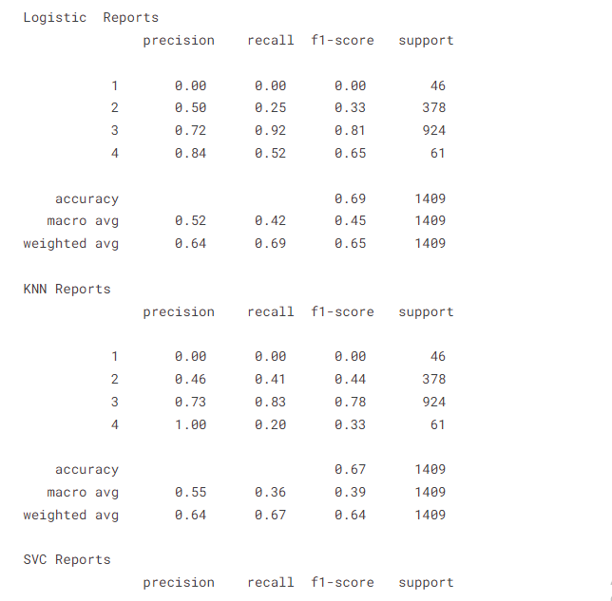
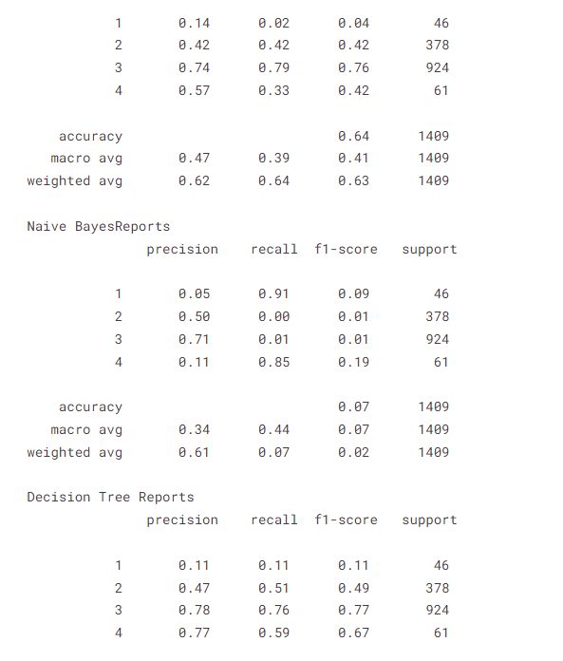
9.Model Comparison
from sklearn.metrics import classification_report print('Logistic Reports\n',classification_report(y_test, y_pred)) print('KNN Reports\n',classification_report(y_test, knnpred)) print('SVC Reports\n',classification_report(y_test, svcpred)) print('Naive BayesReports\n',classification_report(y_test, gaussiannbpred)) print('Decision Tree Reports\n',classification_report(y_test, dtreepred)) print('Ada Boosting\n',classification_report(y_test, abcl_pred)) print('Random Forests Reports\n',classification_report(y_test, rfcpred)) print('Bagging Clasifier',bgcl.oob_score_) print('Gradient Boosting',classification_report(y_test, test_pred)) print('XGBoosting\n',classification_report(y_test, xgbprd))

Slide 54
10.Conclusion
The conclusion is that Random Forest Algorithm along with the gradient boosting have the accuracy of 74.5 and 75.5 respectively.

